Slide 1
https://cran.r-project.org
https://www.rstudio.com
Download R from here
Download R studio from here
(it might make your life easier)

Slide 2


Introduction to R
Gib Hemani

Slide 3


Slide 4

Davis et al. (2012) Molecular Psychiatry, 17, 867-874

Slide 5
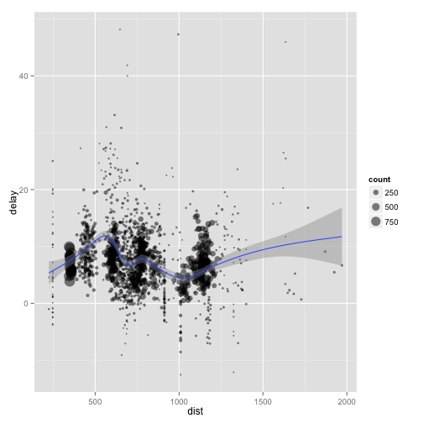
Exploration
Data on 227000 flights that departed from Houston in 2011
For each plane, find how many flights it made, the distance travelled, the delay…

Slide 6
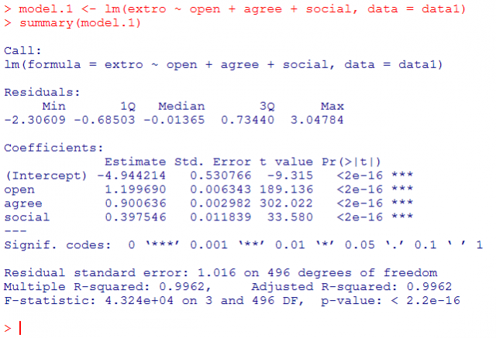
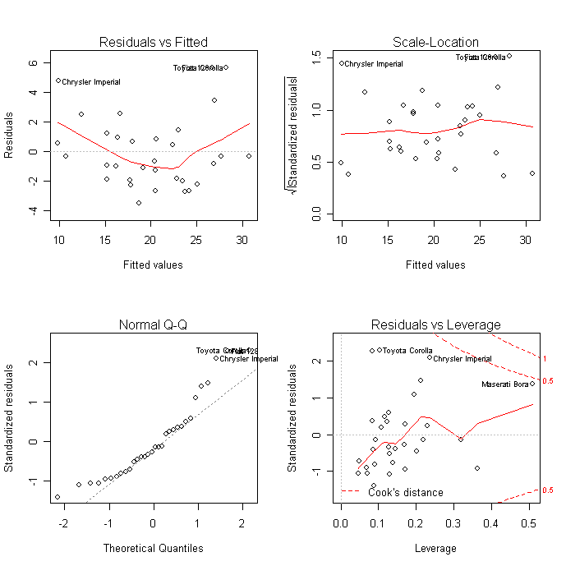
Built by statisticians

Slide 7
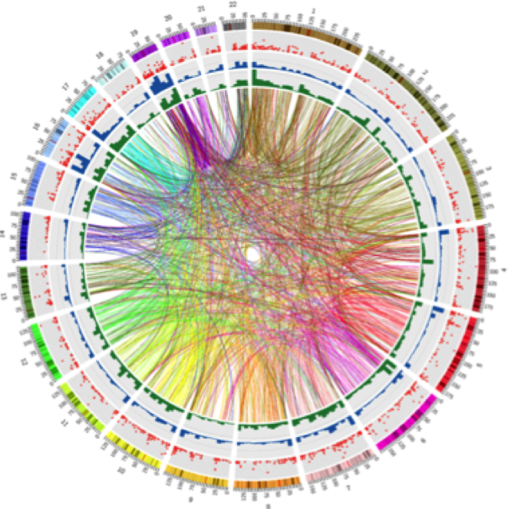
18 trillion tests…

Slide 8
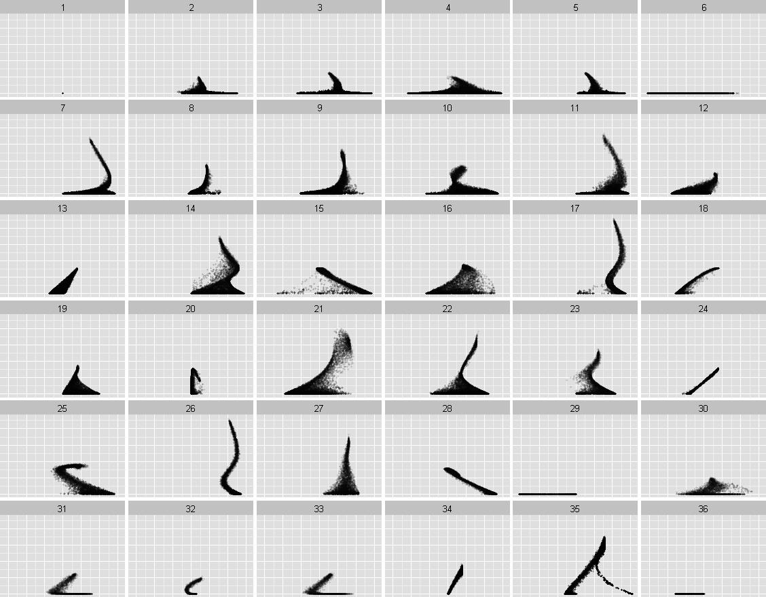

Slide 14
Why use R?
Computational biologists use it
New (relevant) methods are available on R first
Sharing code with collaborators is easier if it’s in the same language
It’s relatively easy to learn
You can do a lot with relatively little code

Slide 15
Learning outcomes
Download and install R
Read in data
Make some plots
Use packages
Understand documentation
Learn how to use R scripts

Slide 16
Object
Assign
Function
Arguments
Translation:
Read a table.
The file is located at “data/genetic/phen.txt”.
The first row is the header.
Don’t store strings as factors.
Save the output from this to a new object called ‘phen’.

Slide 17
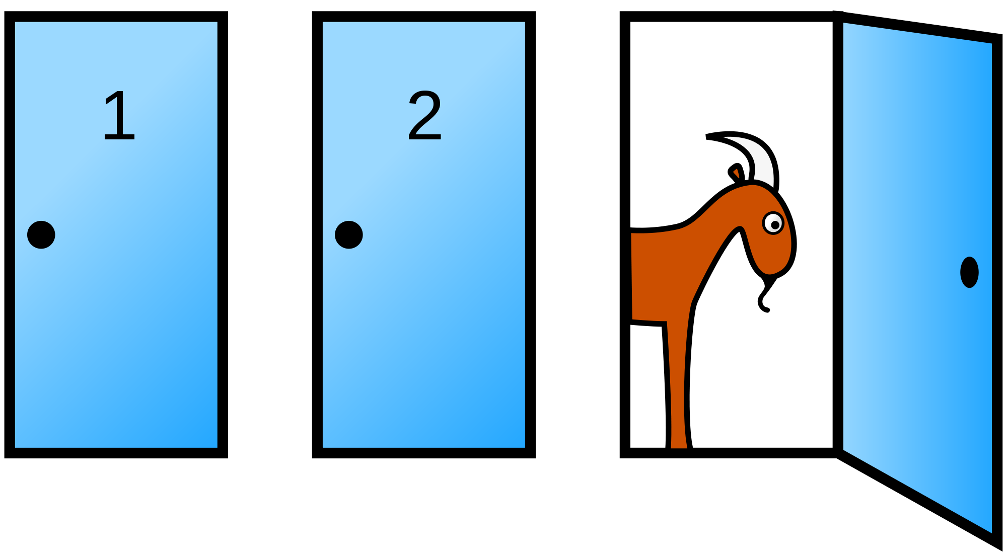
Monty Hall problem
Suppose you're on a game show, and you're given the choice of three doors: Behind one door is a car; behind the others, goats. You pick a door, say No. 1, and the host, who knows what's behind the doors, opens another door, say No. 3, which has a goat. He then says to you, "Do you want to pick door No. 2?" Is it to your advantage to switch your choice?

